Slide 1
Introductory General Chemistry
Chemistry 3A
Experiment 1a
Making Measurements
Mitch Halloran

Slide 2
Introduction
Measurements of mass and of length in one dimension and length in three dimensions to get volume are common in the laboratory
In this experiment you determine mass and volume and length measurements on a metal bar and on pure aluminum shot to get the property of density
Is the metal bar aluminum or another metal based on your calculations?

Slide 3
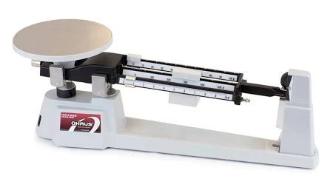
Background
Measuring mass. We did this last week with small amounts of table salt (sodium chloride, NaCl) and of DI water using the electronic balance. An electronic balance has a maximum capacity. Other scales, like a (triple-)beam balance are used for heavier objects
Measuring volume. We need an accurate
volume measurement. It will be done in two
ways:
Using a ruler to measure the lengths
and calculate usually in three dimensions (width, height, breadth)
Displacement of water in a measuring container such as a graduated cylinder. Sufficient water to fully immerse the object is filled in the cylinder and an initial reading taken. The object is immersed in the cylinder with water (it MUST be completely immersed), then the final reading is taken.

Slide 4
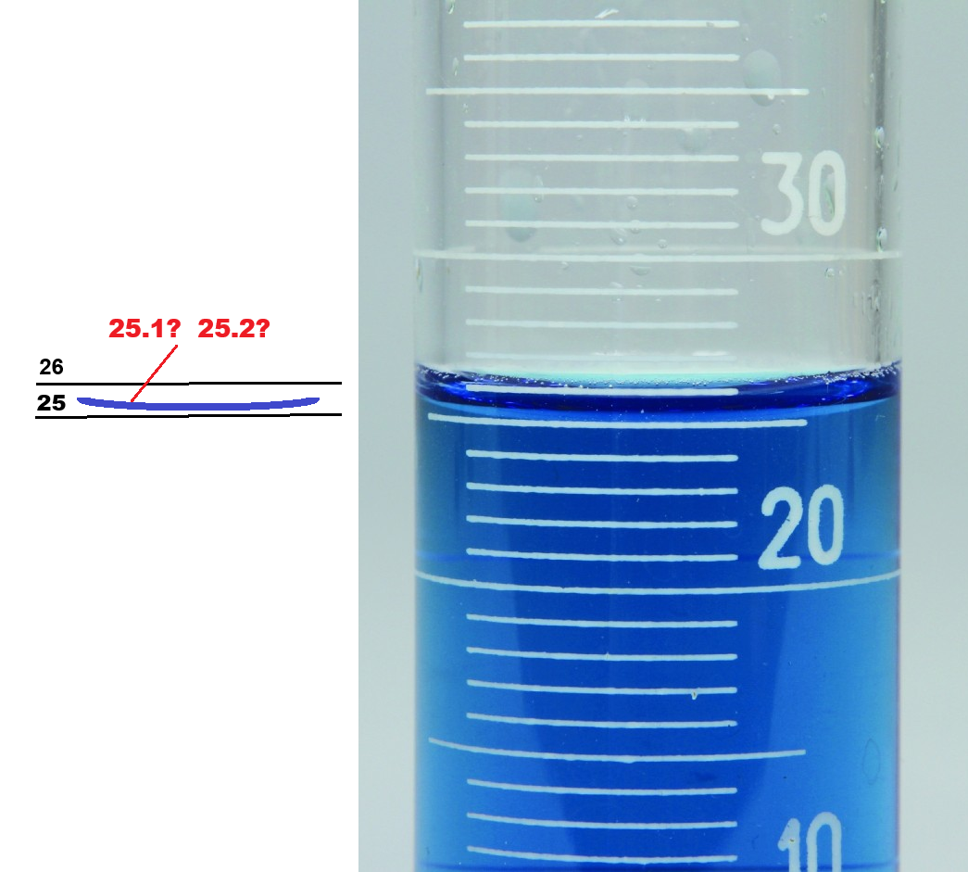
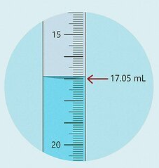
A Note About Reading Precision
Volumetric devices / instruments / containers like a buret and graduated cylinder have markings (the major markings have numbers)
It is asserted that if an instrument has 1 mL markings like a graduated cylinder, it is precise to one-tenth of that, that is, ±0.1 mL
If it has 0.1 mL markings like a buret, it is precise to one-tenth, or ±0.01 mL
User your best judgment

Slide 5
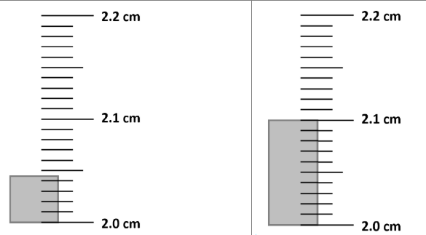
Notes on Measurement Precision
Look at the smallest division mark. What is its value?
  1 mL? 0.1 mL? 0.01 mL? 0.001 mL?
Now take one-tenth of the division mark value: multiply by 0.1 or by 10%. Or divide by 10
  That is your precision!

Slide 6
Notes on Measurement Precision
left
Division mark: 0.01 cm
Precision = 0.01 cm x 10% = 0.001 cm
Measure = 2.045 cm ← precise to 0.001 cm!
right
  Division mark: same as 1(a) → 0.01 cm
  Precision = same as 1(a) → 0.01 cm x 10% = 0.001 cm
  Measure = 2.10 cm but precise to 0.001 cm → 2.100 cm

Slide 7
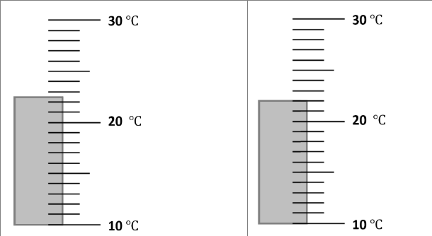
Notes on Measurement Precision
 | Division mark | Precision | Measure
left | 1°C | 0.1°C | 22.5°C | Precision = division mark x 10%
right | 1°C | 0.1°C | 22.0° | Not “22°C”

Slide 8
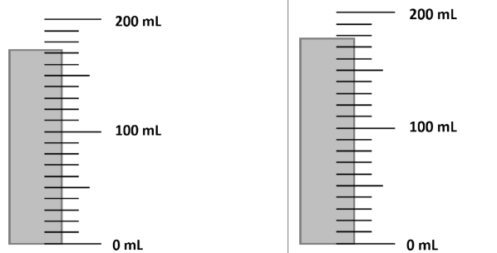
Notes on Measurement Precision
 | Division mark | Precision | Measure
left | 10 mL | 1 mL | 172 mL | Not “170 mL” or “172.0 mL”
right | 10 mL | 1 mL | 178 mL

Slide 9
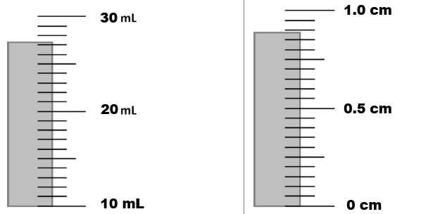
Notes on Measurement Precision
 | Division mark | Precision | Measure
left | 1 mL | 0.1 mL | 27.2 mL
right | 0.05 cm | 0.005 cm | 0.880 cm | precise to 3rd decimal digit

Slide 10
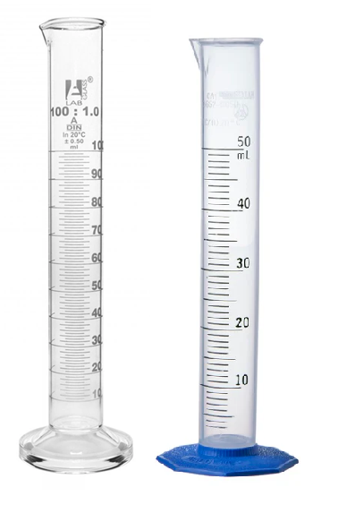
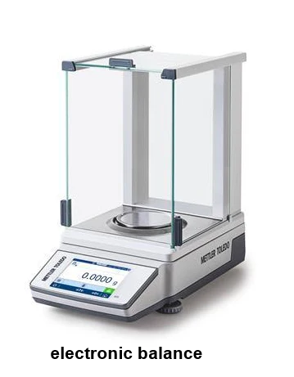
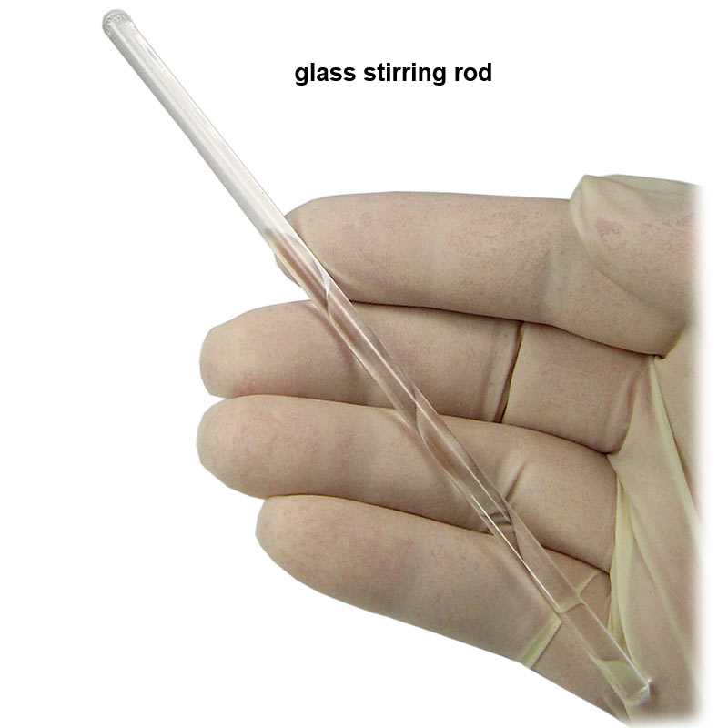
Equipment You Will Use

Slide 11
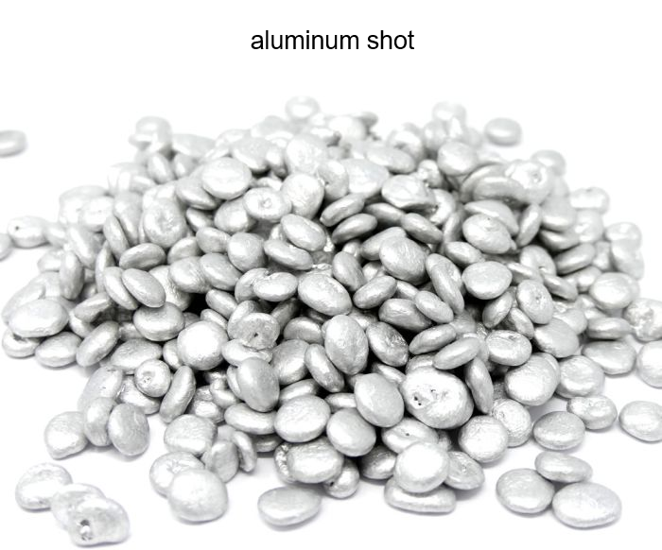
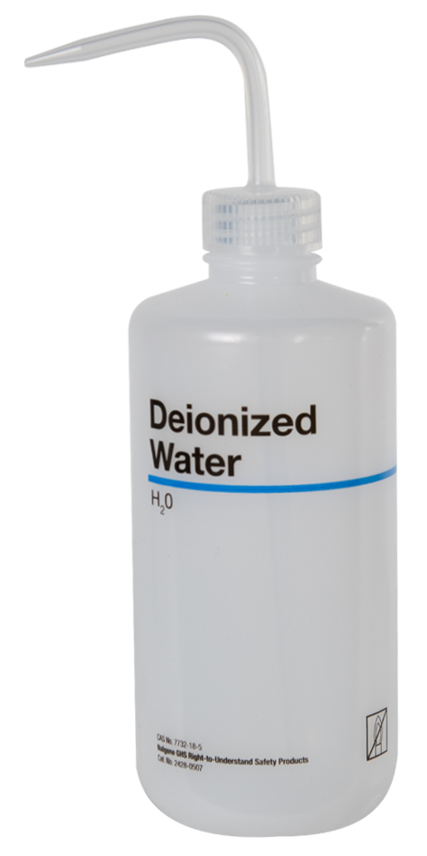
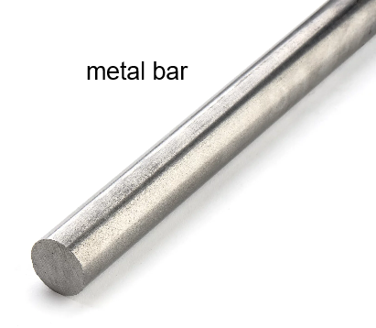
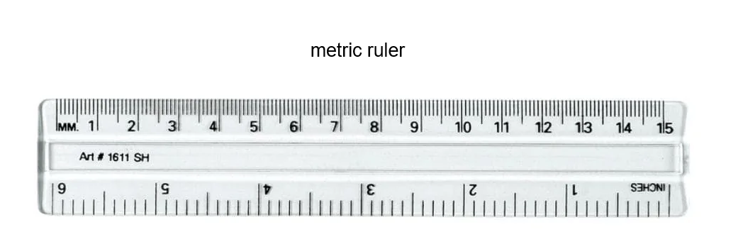
Equipment You Will Use

Slide 12
Procedure
Equipment/Material Needed
weighing balance | metric ruler
50 or 100 mL graduated cylinder | 10-30 g aluminum shot
glass rod
Consumables Needed
DI water (~60 mL)
p. 22: record identifier on metal bar; describe its appearance
measure bar mass. Record all digits on balance
Use ruler to measure bar dimensions; use significant digits
Use water-filled graduated cylinder to measure volume. Make sure it is fully immersed! Make sure to use glass rod to tap out air bubbles on any object measured by volume displacement method
Record your data and make your calculations, taking care to express results using significant digits

Slide 13
Clean Up
Use paper towel to dry the aluminum shot, then put in the “return metal” container. Also dry the metal bar before putting in container
Empty the water bottle before putting it back
Place all other equipment from where it was obtained

Slide 14
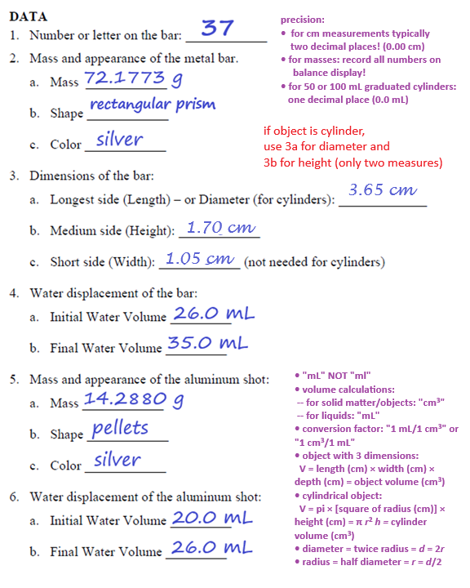
Example Data Analysis

Slide 15
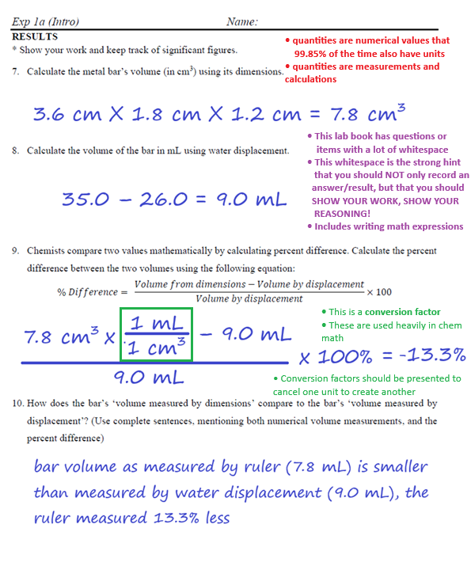
Example Data Analysis

Slide 16
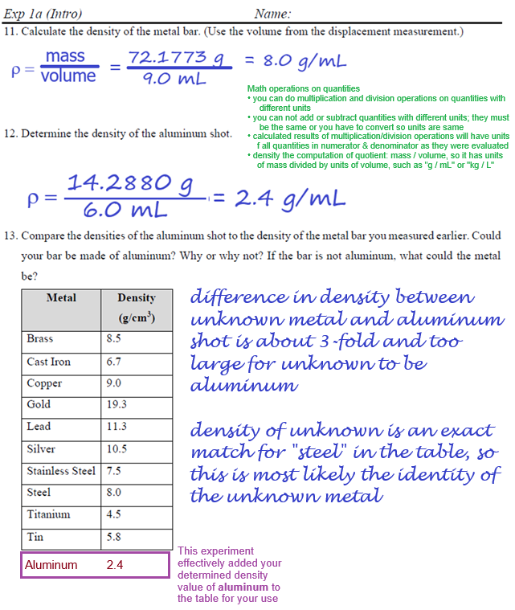
Example Data Analysis

